Slide 1
Micro service with responsive ui
NoSQL platform as data storage, API based, Micro services and highly responsive UI

Slide 2
Technology & Platform
Platform: Java, Spring Boot, NoSQL(mongodb), Micro Service
Documents: Architecture Diagram
Plugins: Cloud Eureka & Zuul Proxy, Thymeleaf, Bootstrap, font-awesome, google map, ckeditor

Slide 3
Points Covered
Created an application using micro service design pattern with different UI elements and mongo DB at back end to store user information.
Created API-Gateway to establish communication between UI service and mongo service.
Flexible/Responsive UI with different elements.
Elements in UI:
-> CKEditor.
-> Google Map.
-> Slide show with images
-> Image rendering in the screen.
-> File handling.
-> Text, number, drop down, multi select, date picker, radio button, check
box, dynamic content, text area and button.

Slide 4
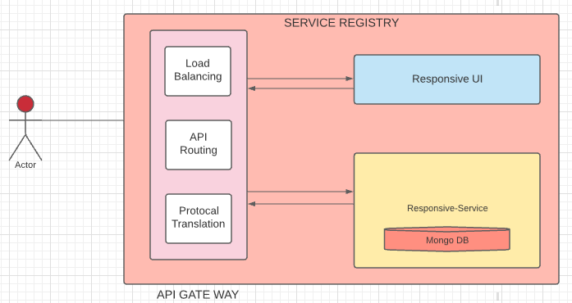
Architecture diagram

Slide 5
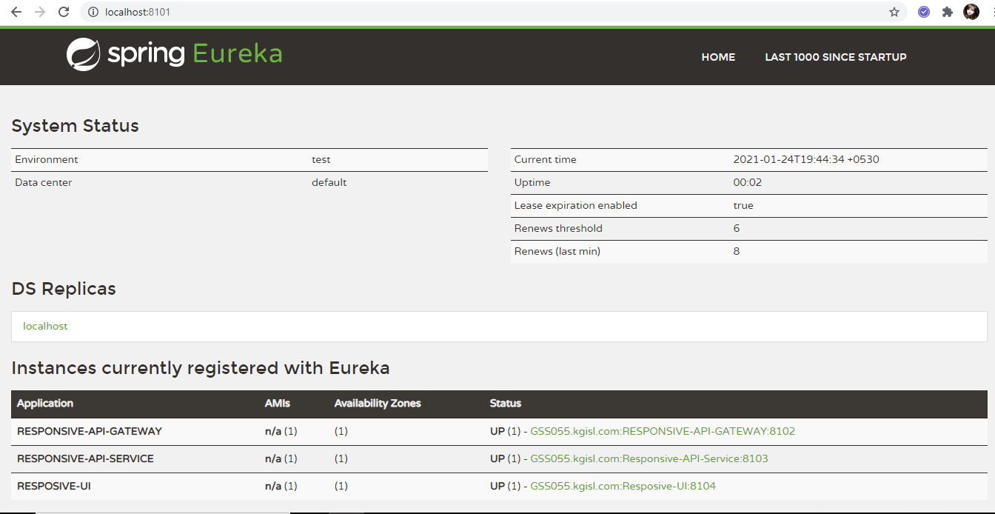
Service registry

Slide 6
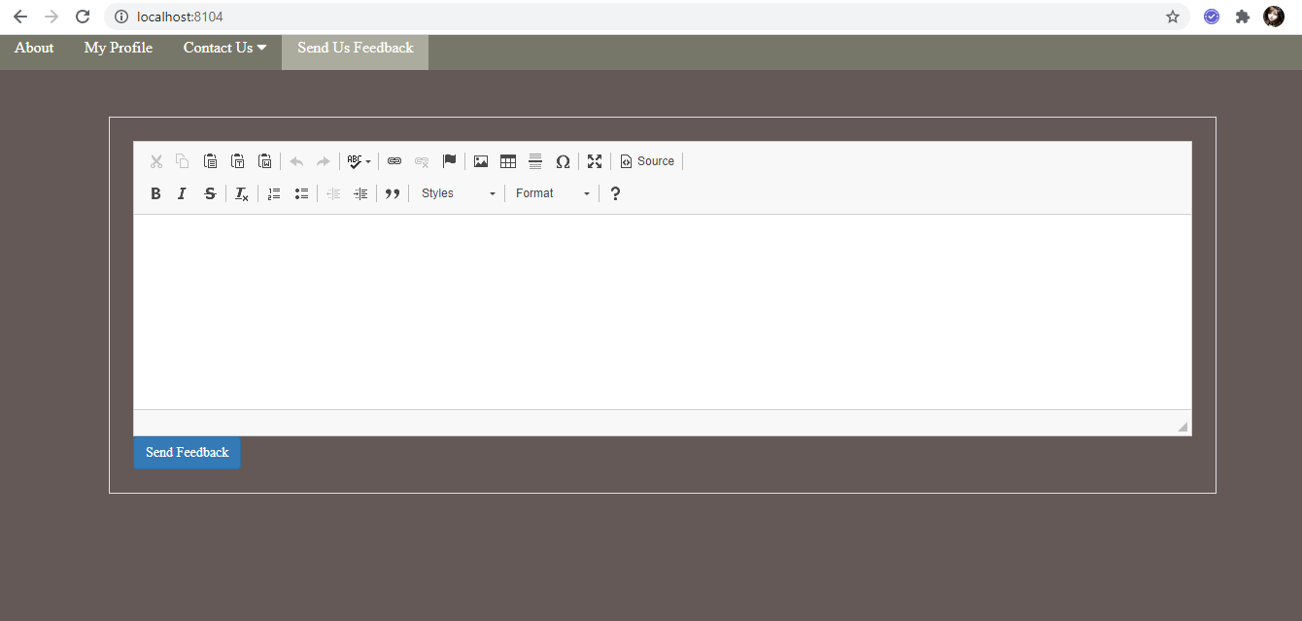
Ckeditor screenshot

Slide 7
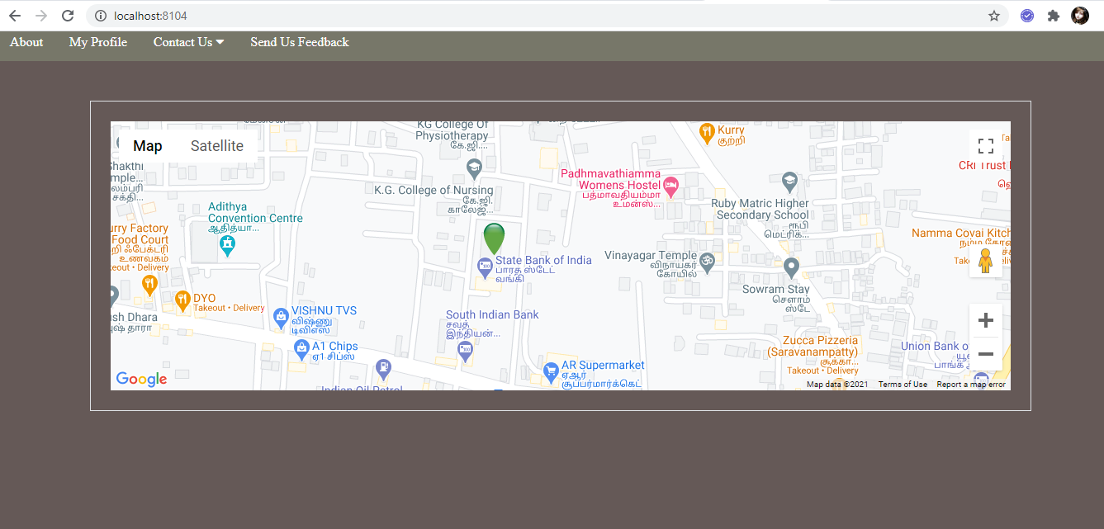
Rendering google map

Slide 8
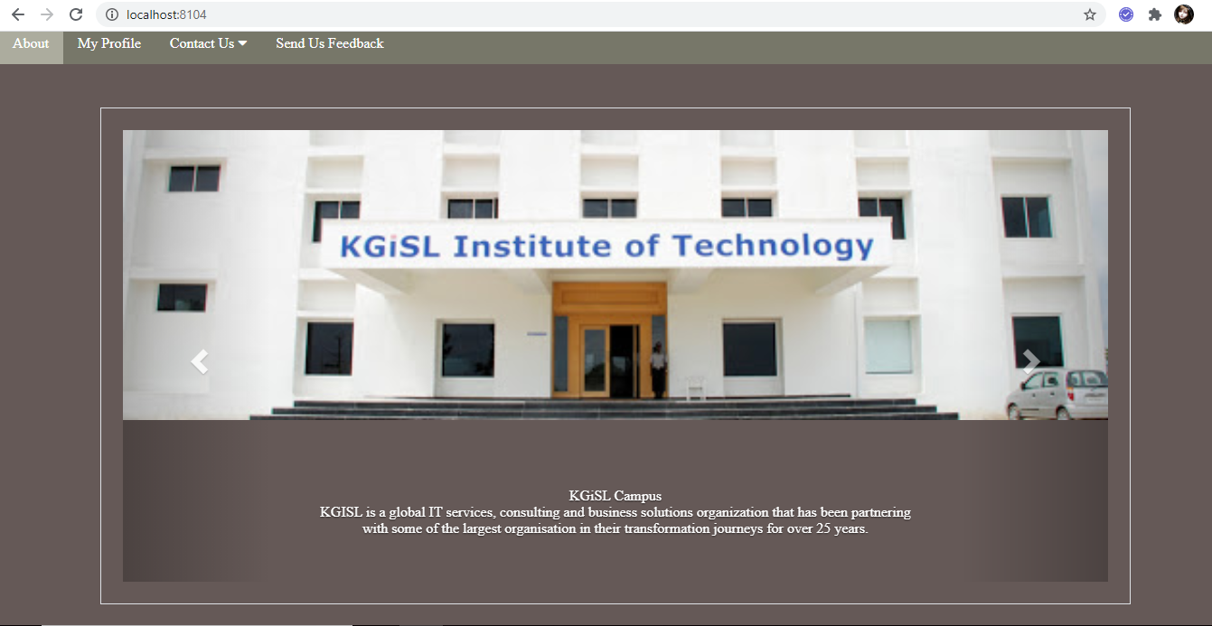
Slideshow in the screen

Slide 9
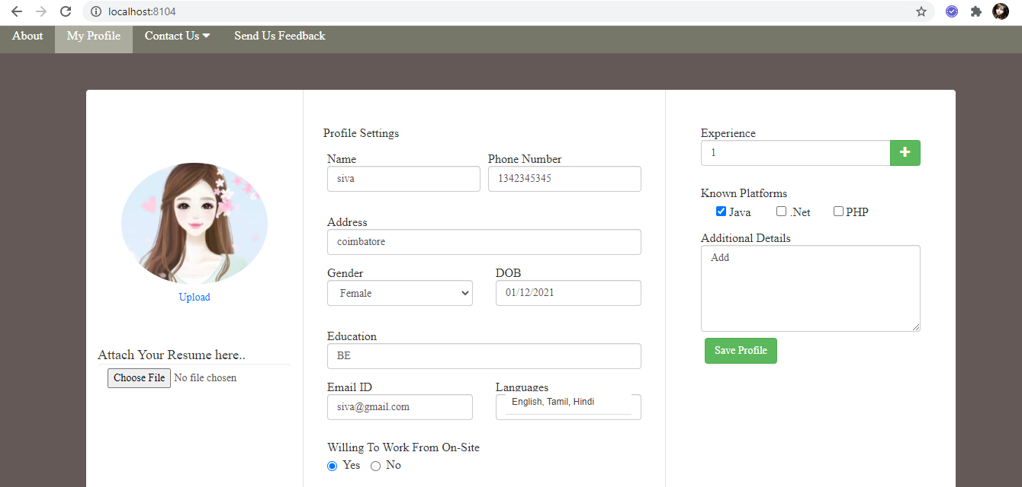
UI with other elements

